Slide 1
Blackbird – Smart Data Collection
WiFi Positioning for Crowd management
By Peter Savnik

Slide 2
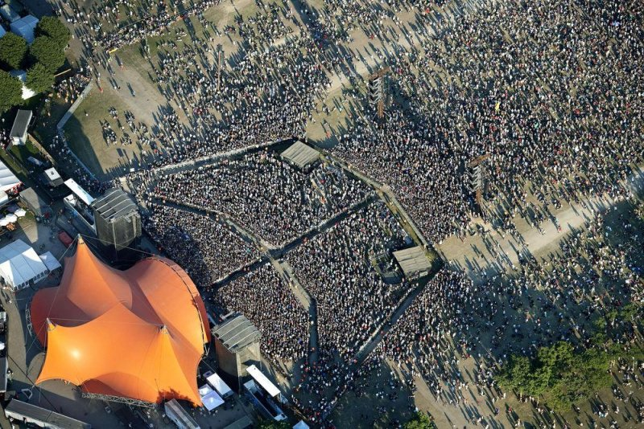
21.5M datapoints
1.5M Positions
80K Unique
Bilede: Roskilde Festival

Slide 4
Crowd Density

Slide 5
Crowd Speed and Direction

Slide 8
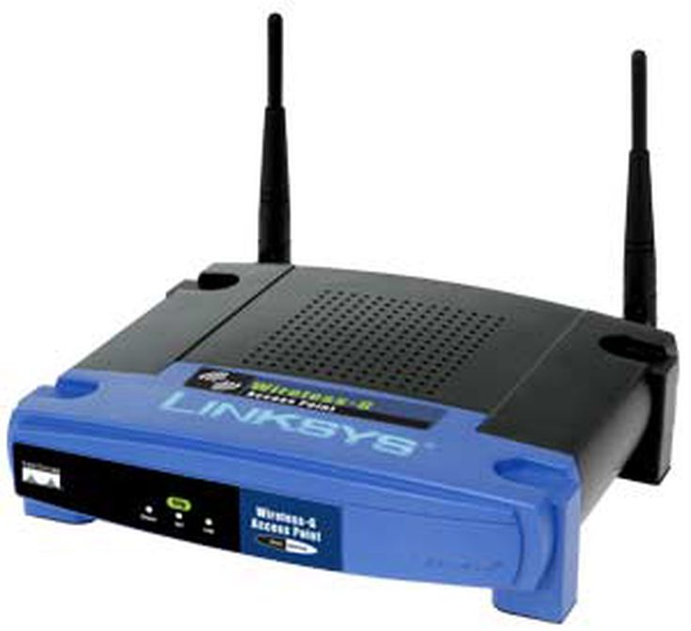
How It Works
WiFi B
Probe Request
WiFi A
WiFi C
Probe Response

Slide 9
Frequency

Slide 10
But what if my WiFi is off?
It is never off

Slide 11
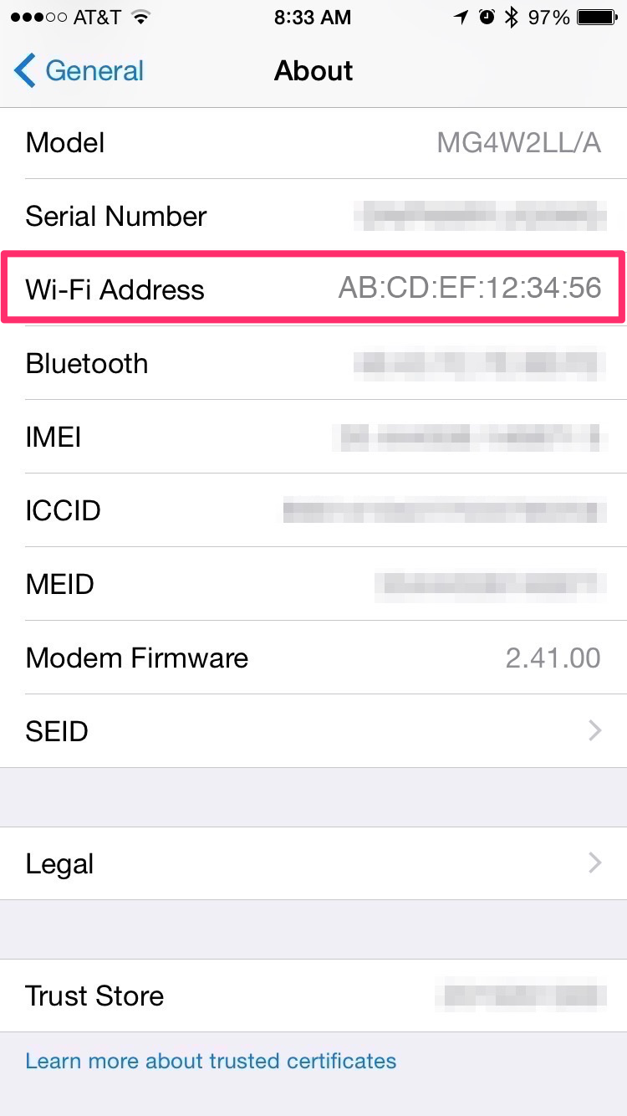
My Iphone spoofs my MAC… I’m Safe
NOPE!
Whitepaper: ZerbraTechnologies. Analysis of IOS 8 MAC Randomization on Locationing. Technical report, 2014.

Slide 12
What About the Cookie Order?
You cannot collect data without written consent Unless…
If it is not possible to get a written consent and anonymise the data
Or an Art installation
Ref: Erhvervsstyrelsen. Afgørelse vrd. BlipTrack, 2015

Slide 13
Data turned into knowledge is the “energy” in the 4th Industrial revolution
Knowledge
Product
Raw materials
Business operation
Services
People
Method
Utilities
Machines
How Blackbird fits in:
Blackbird is offering technology and services that help companies speed-up the digital transformation.
It collects data and analyzes information, provides knowledge and insights without complex IT project and large investment.

Slide 14
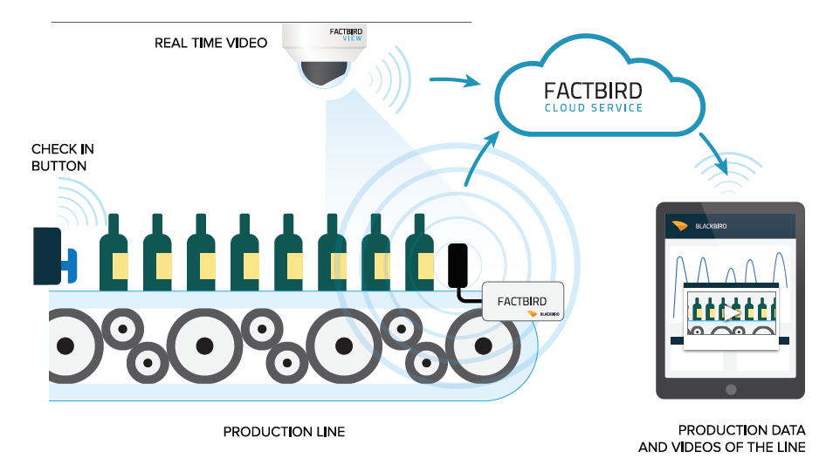
Blackbird - Access to data in less than an hour
Wifi/Ethernet
LoRa
Mobile
network
No wire, No complex IT project – Quick, plug and play implementation
No large investment – Lower barrier for purchasing decision
No connection to existing equipment or control system - Retro fitting on production machines
No special software installation – Access data from existing devices: Smartphones, tablets and PCs

Slide 15
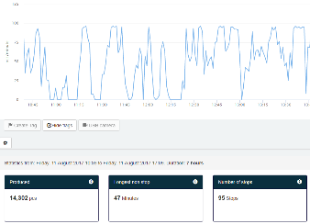
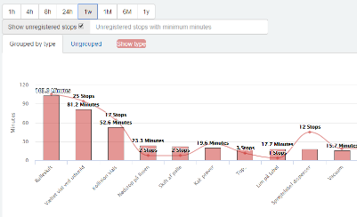
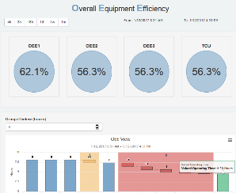
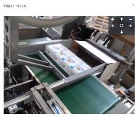
Factbird – Smart Data Collection
Factbird boxes are installed on production equipment or any other point where data collection is required
The technology is real time, and based on cloud computing and data transmission via the mobile network or client WIFI – No PLC integration required
Customers access statistics on www.blackbird.online, using computers/tablets/mobile phones, and gain value by aiming improvement actions at the biggest operational challenges
Live production data and KPI’s
Stop-cause pareto charts
OEE 1-3 waterfalls charts
Process video documentation

Slide 16
Thank you for your time

